Slide 1
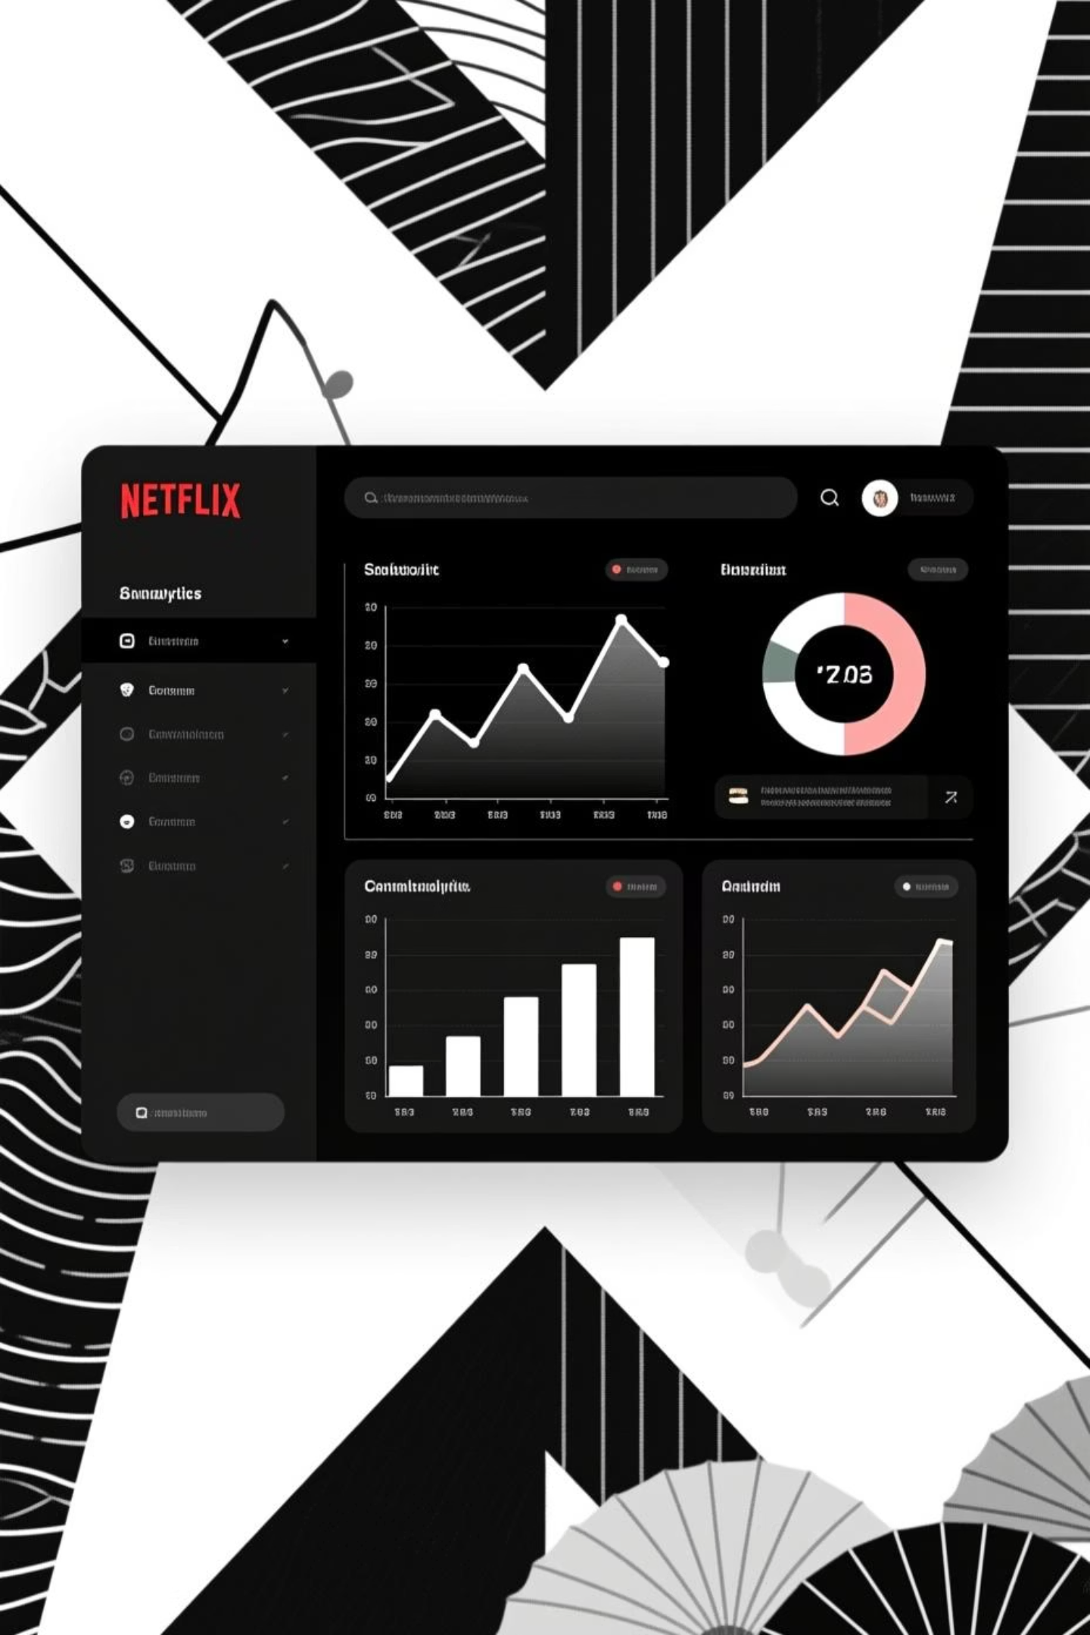
Transforming Netflix Data with dbt
A Modern Analytics Pipeline
End-to-end cloud-native data transformation from raw ingestion to analytics-ready insights.

Slide 2
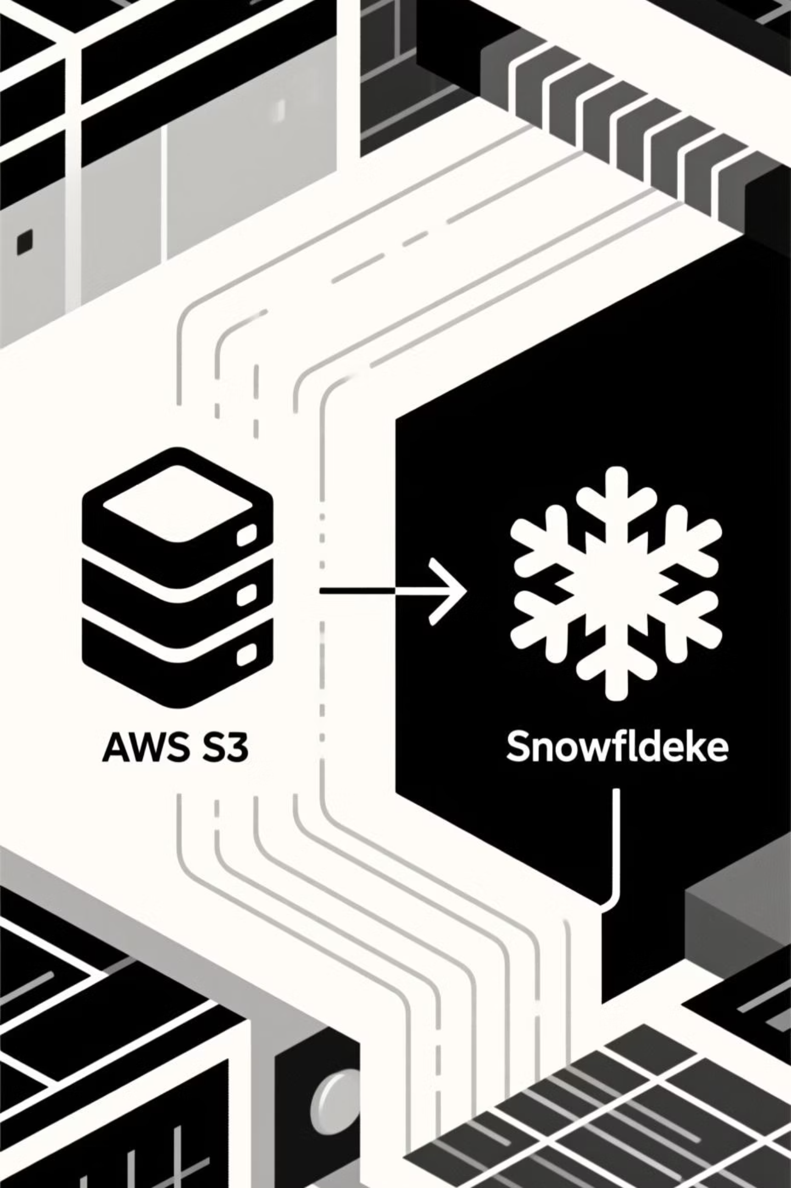
Project Overview
Objective
Scope
Analyze Netflix viewing patterns using modern cloud-native analytics tools and best practices.
Complete pipeline from raw data ingestion through analytics-ready dimensional models.
Tech Stack
AWS S3, Snowflake, dbt, and GitHub for version control and CI/CD automation.

Slide 3
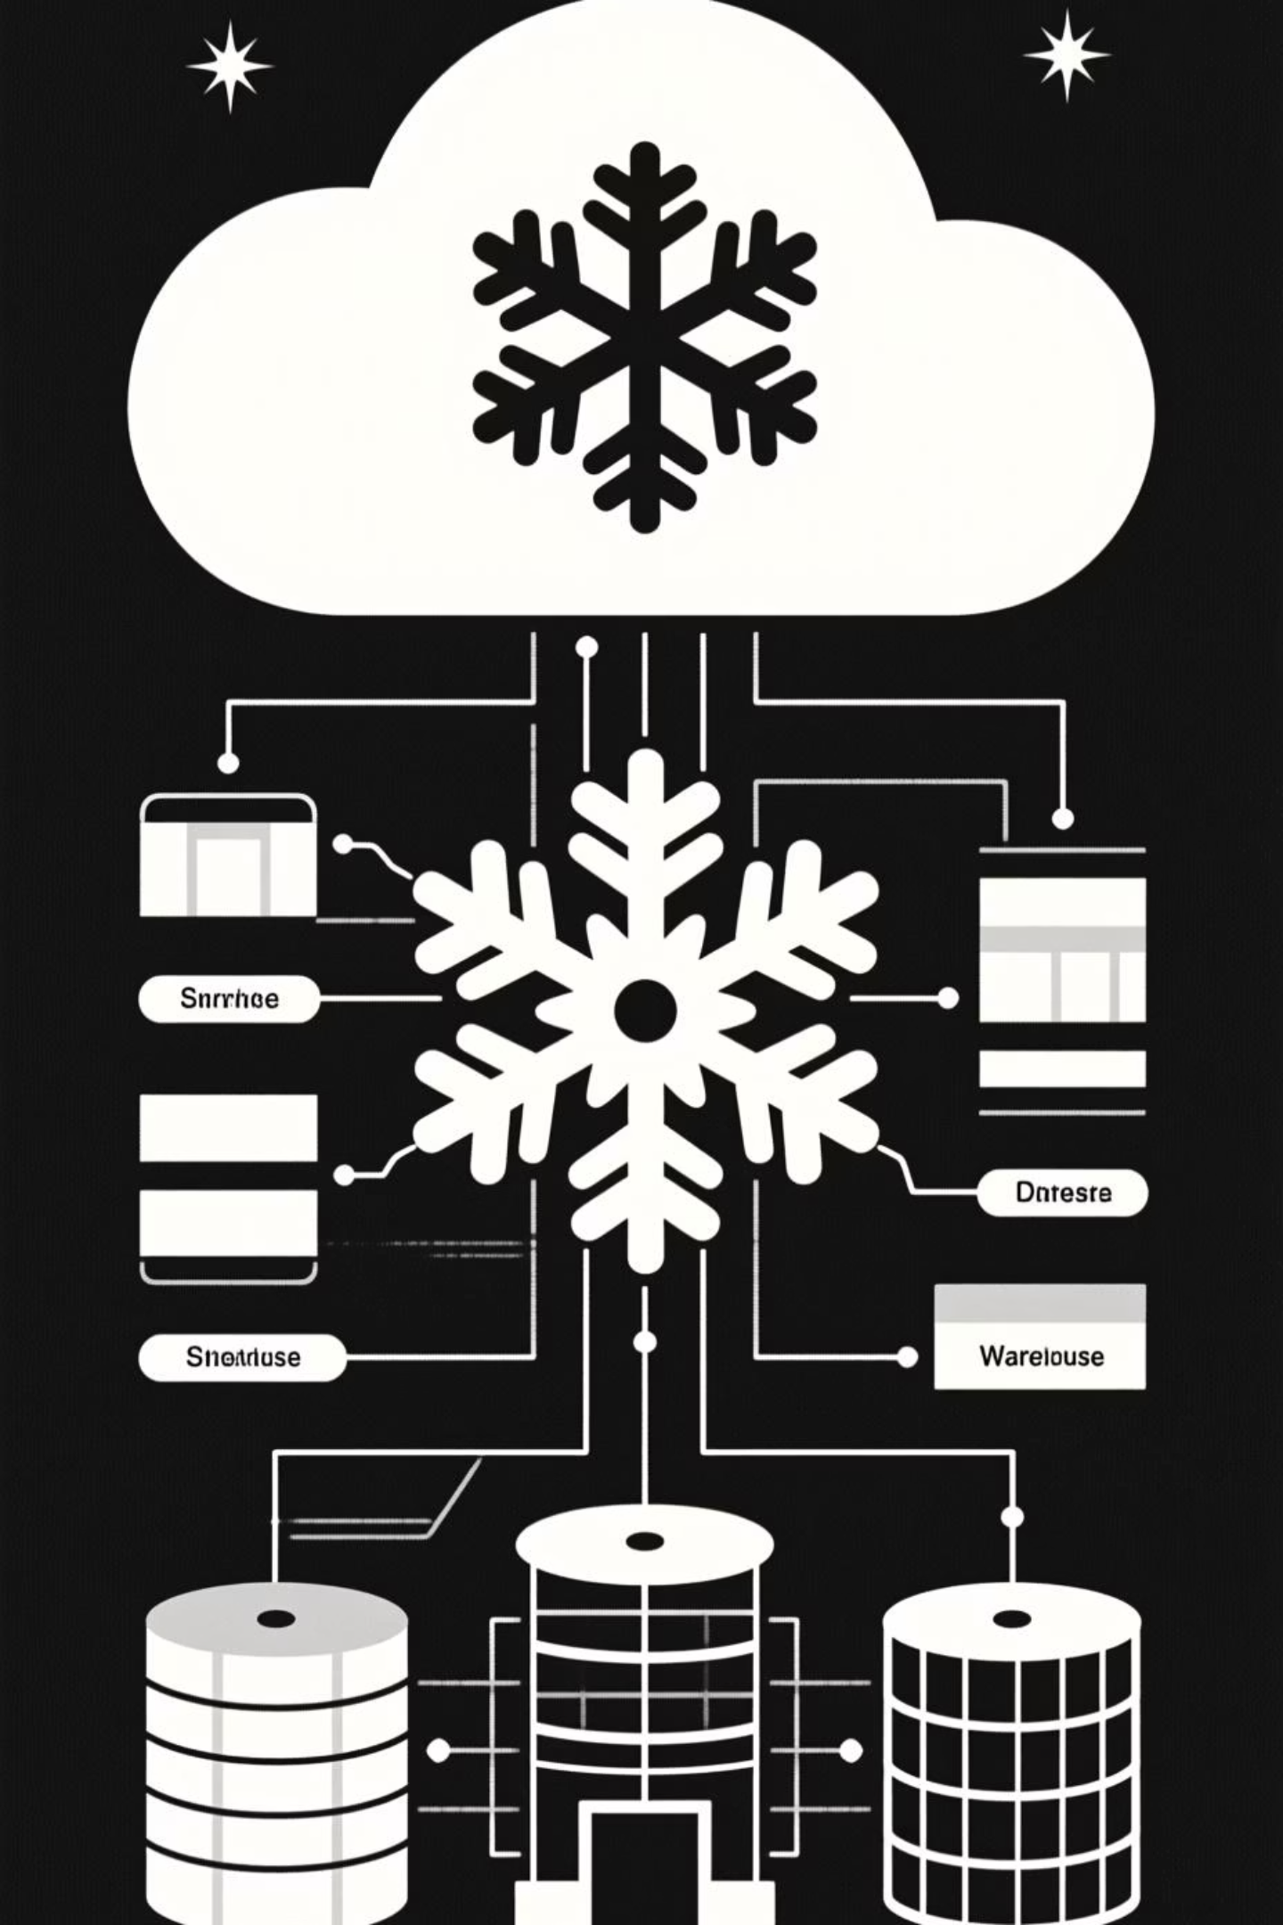




Cloud Architecture & Data Flow
Our architecture follows a structured medallion pattern, moving data from raw to refined layers.
AWS S3
Raw data lake storage
Snowflake
Data warehouse and transformation engine
dbt
Transformation and testing orchestration
Analytics
Ready-to-use business models

Slide 4
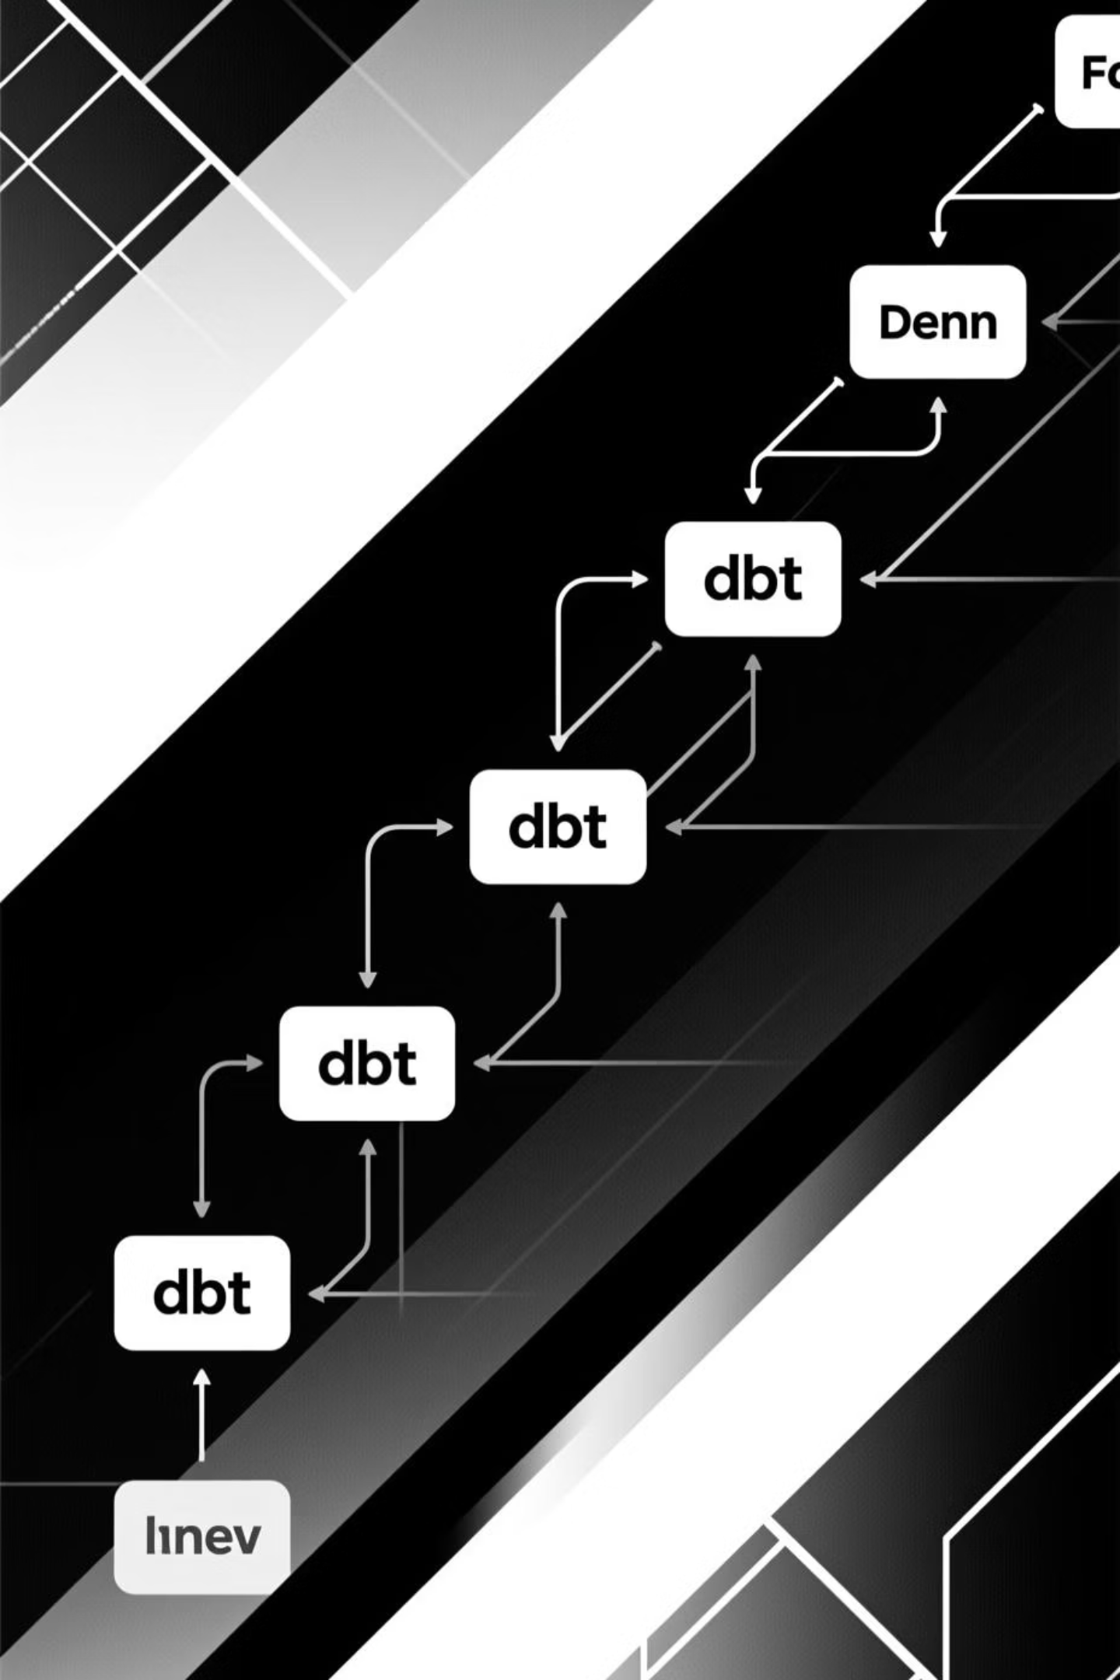
Why dbt? Core Concepts
dbt revolutionizes data transformation by bringing software engineering best practices to analytics.
Modeling Approach
Quality & Documentation
SQL-first with modular design
Built-in data quality tests
Jinja templating for dynamic queries
Auto-generated lineage graphs
Layered structure: staging → intermediate → marts
Version control integration with Git

Slide 5

dbt Advantages
Modularity
Data Quality
Reusable, maintainable models that scale with complexity.
Automated testing ensures accuracy and trust in all analytics.
Collaboration
CI/CD Automation
Git-based version control enables team workflows and auditability.
Seamless deployment pipelines with automated builds and testing.

Slide 6








Key Insights from Netflix Data
Genre Trends
Engagement Metrics
Drama and comedy dominate viewing preferences globally.
Peak viewing occurs between 8-11 PM across regions.
Regional Preferences
Time Patterns
Content consumption varies significantly by geography and language.
Weekends show 35% higher engagement than weekdays.

Slide 7

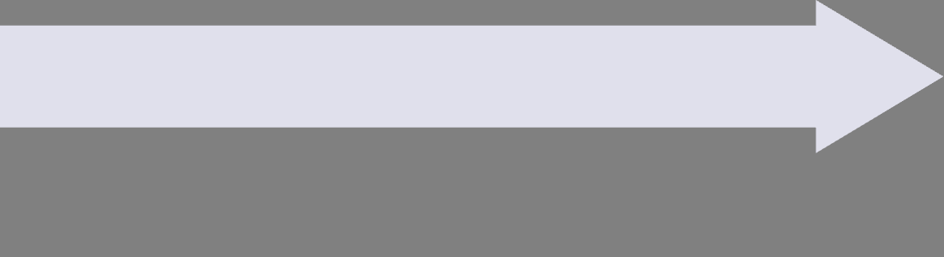
Impact & Results
Transparency
Reliability
Complete lineage graphs and version control provide full auditability.
Scalability
Automated testing and documentation ensure consistent, trustworthy analytics.
dbt enabled handling of millions of rows with clear, maintainable code.

Slide 8

Future Scope & Next Steps
Immediate
Long-term
Expand data retention
Integrate predictive ML models
Add real-time metrics
Automate ingestion workflows
Multi-platform analysis
Advanced personalization insights
Key Takeaway: dbt, Snowflake, and AWS created a scalable, testable, transparent foundation for data-driven decision-making at Netflix scale.

